Slide 1
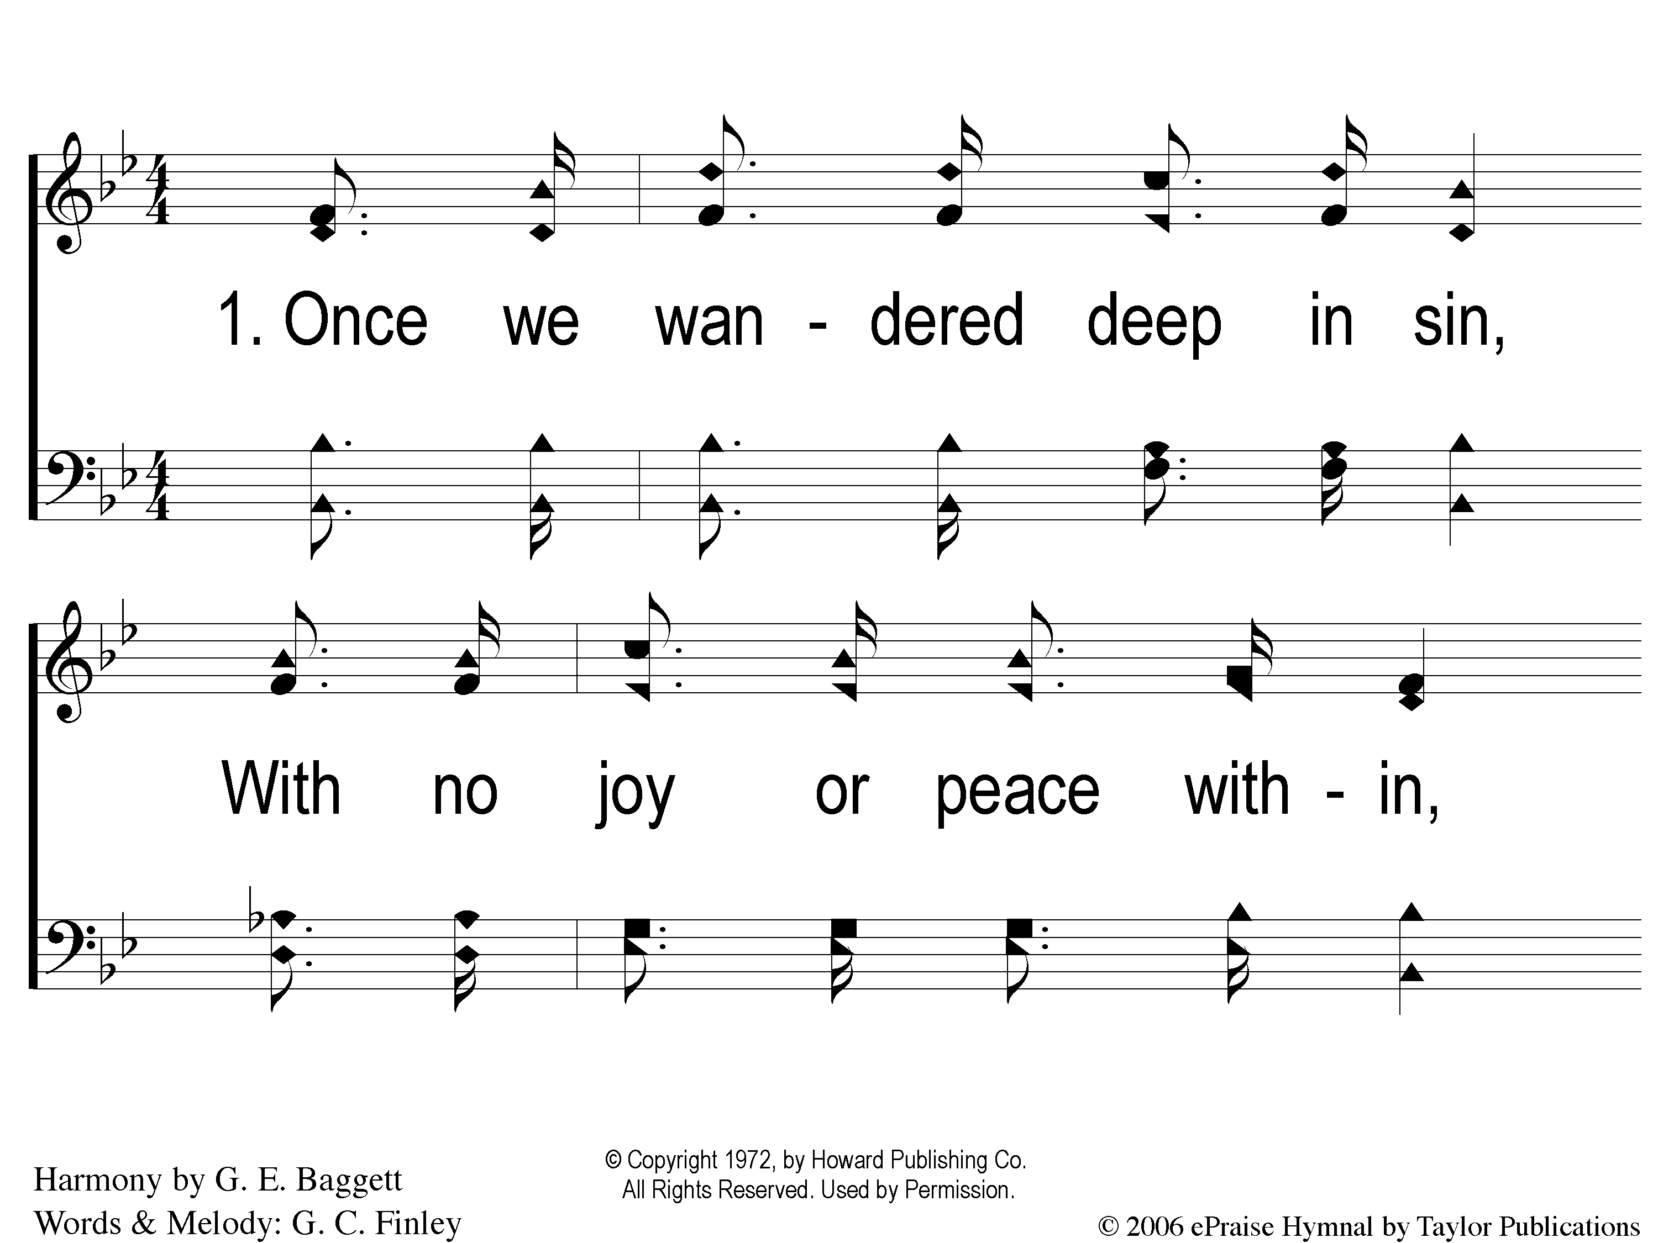
1-1 Oh What Love
Oh What Love
117

Slide 2
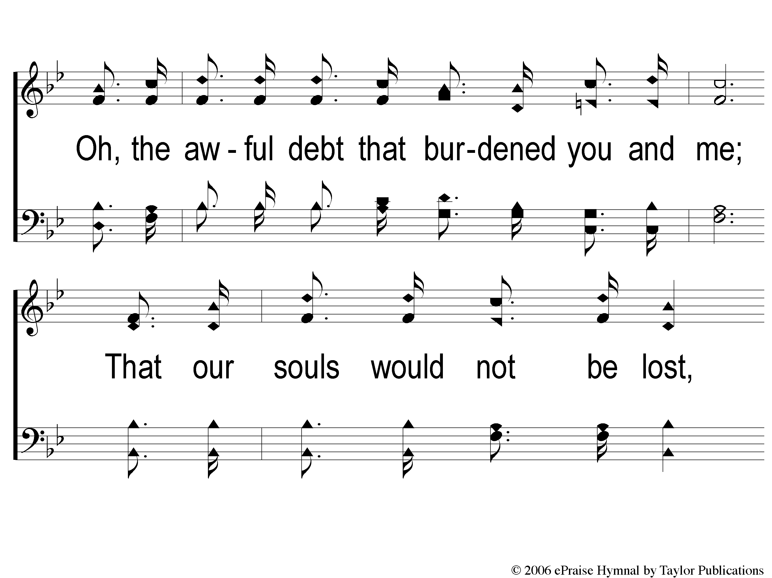
1-2 Oh What Love
Oh What Love
117

Slide 3
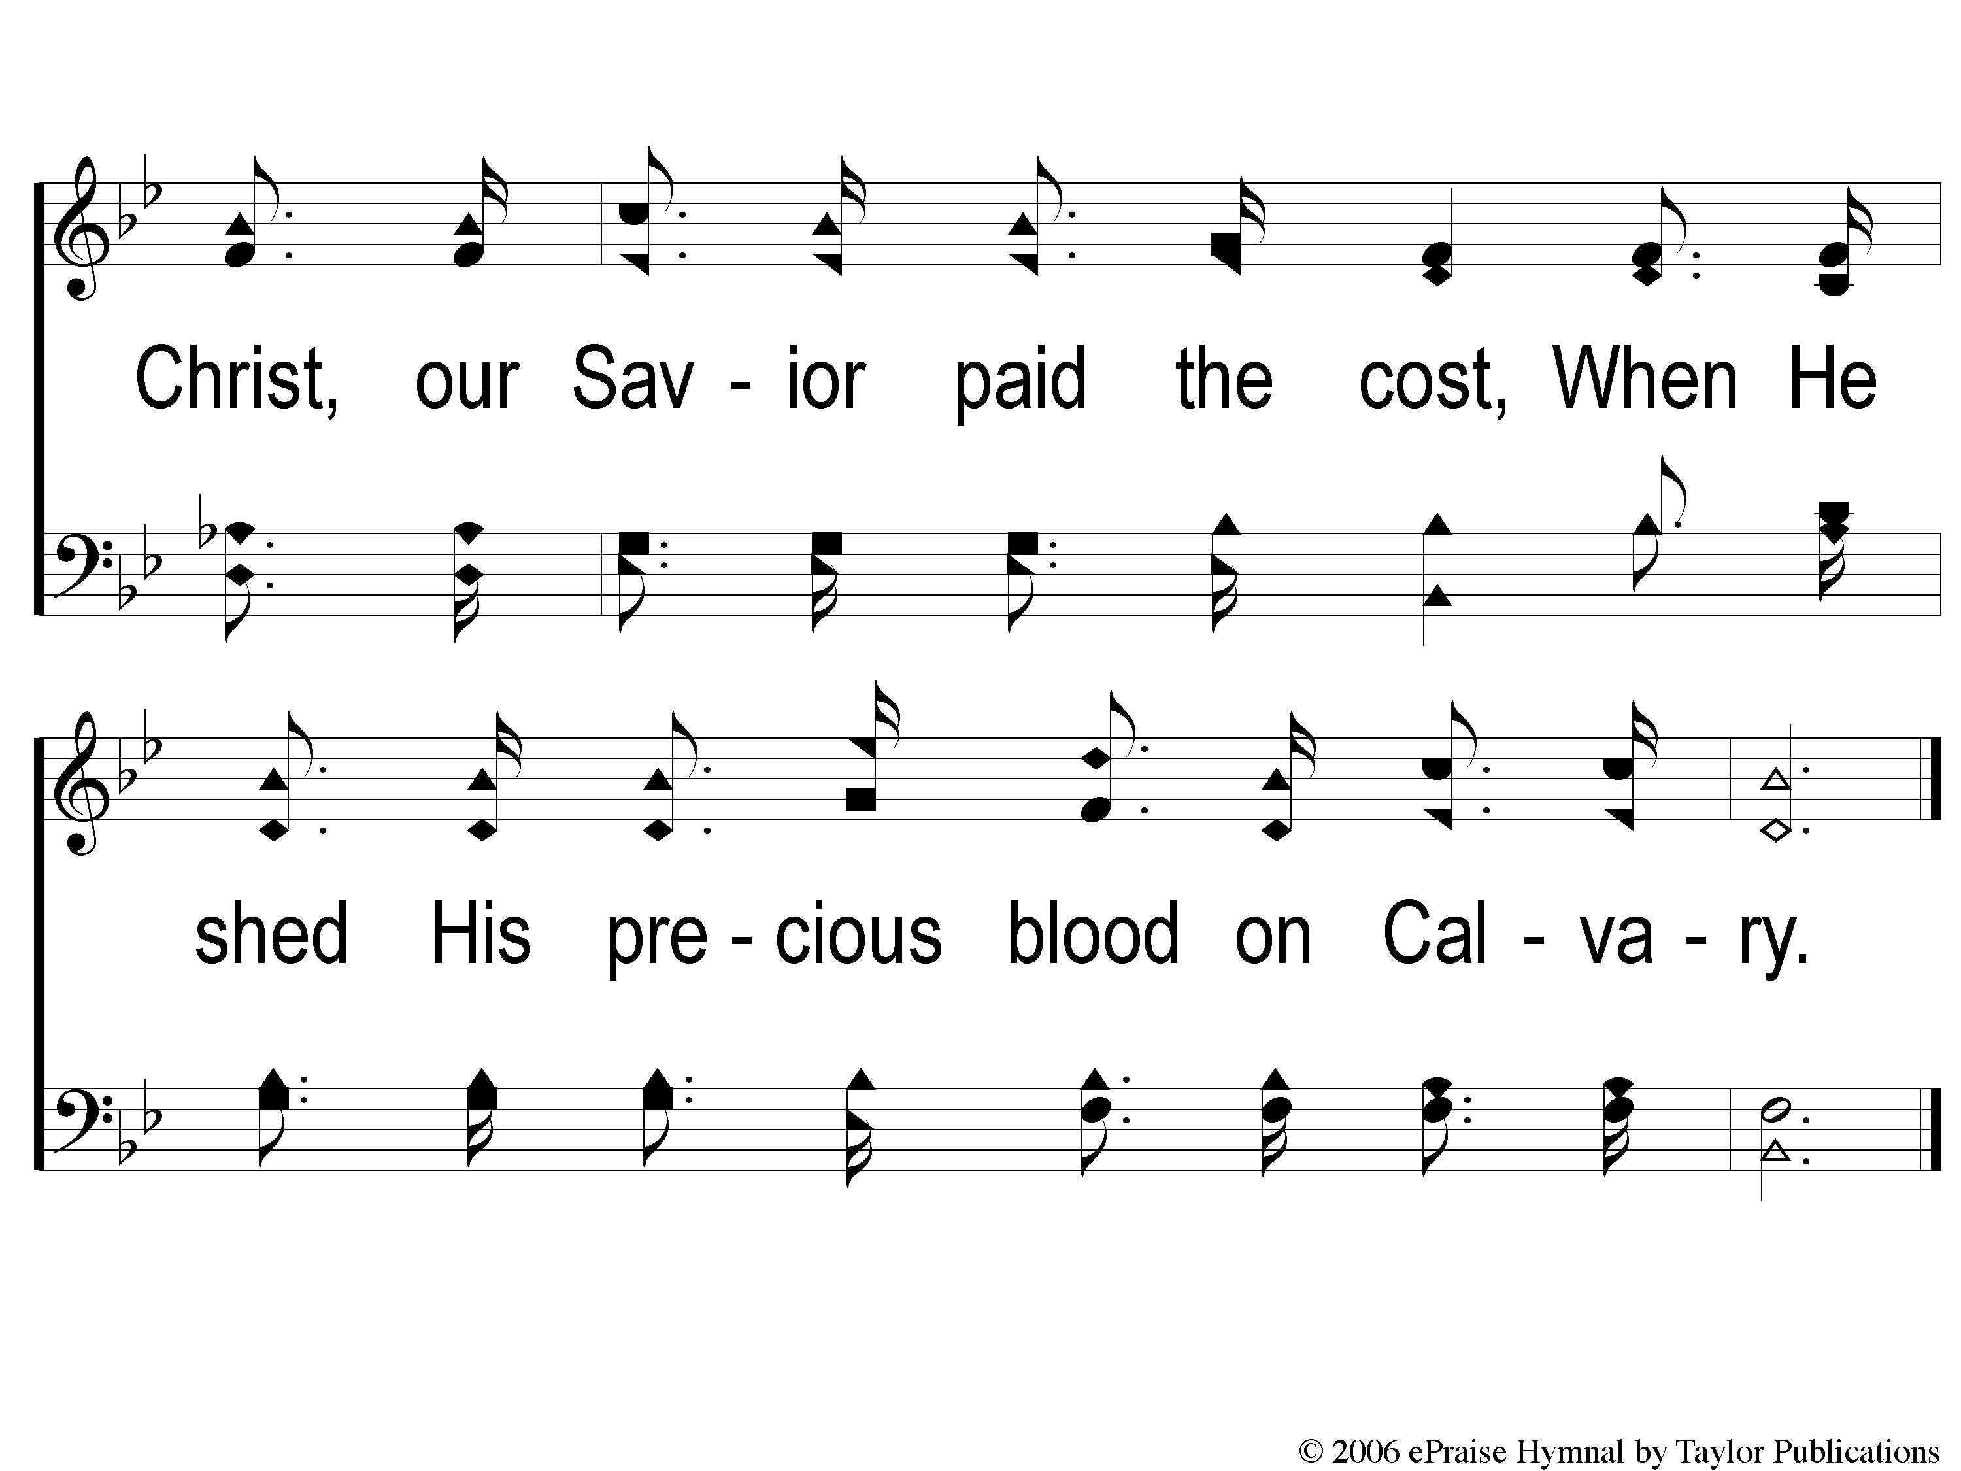
1-3 Oh What Love
Oh What Love
117

Slide 4
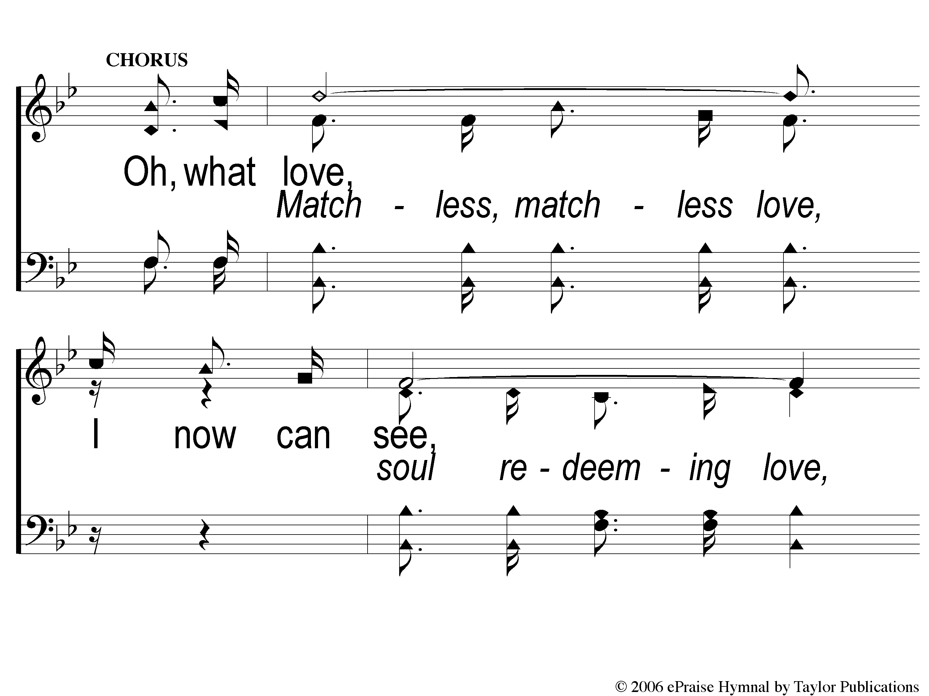
C-1 Oh What Love
Oh What Love
117

Slide 5
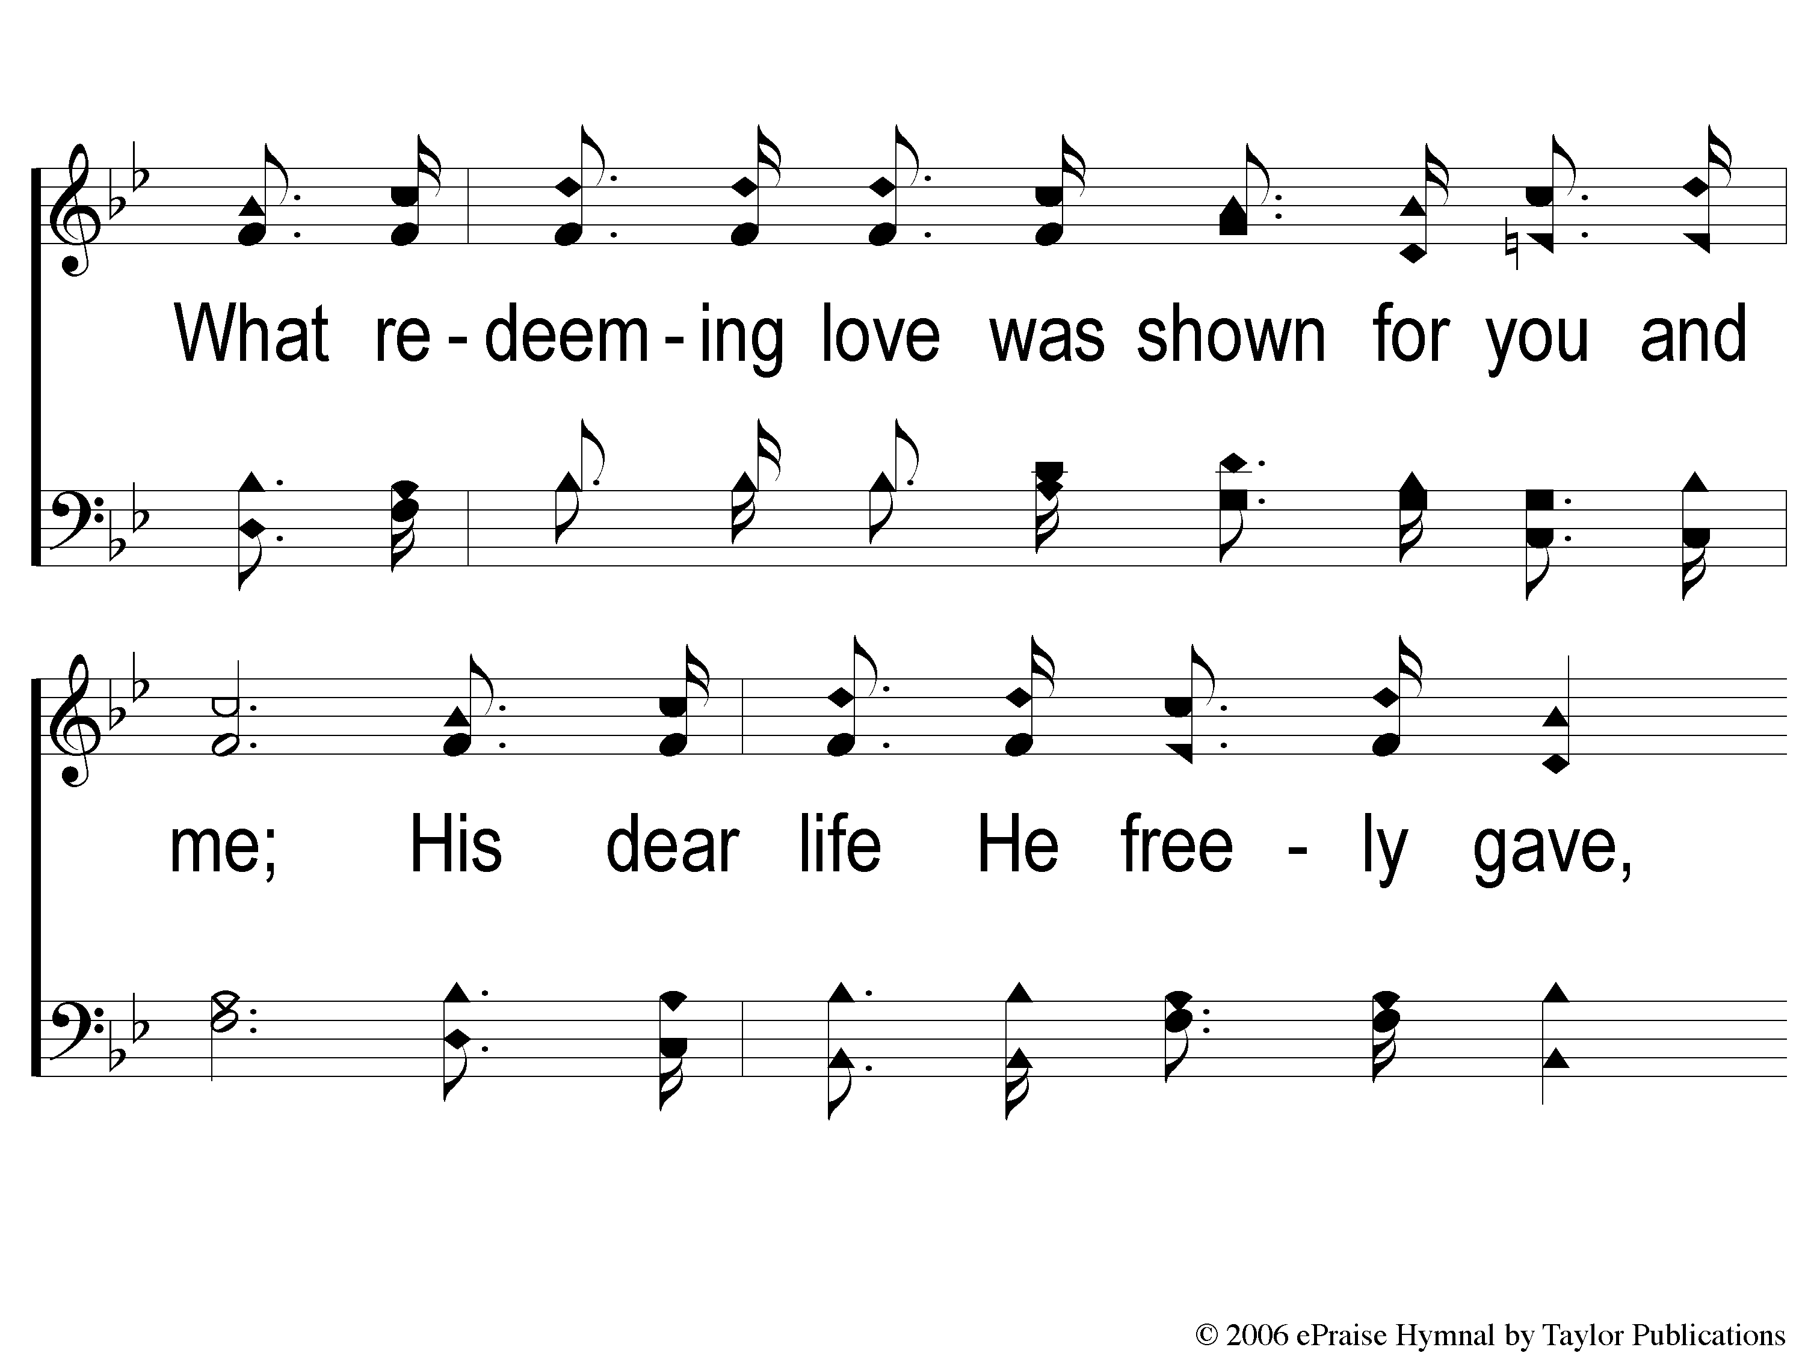
C-2 Oh What Love
Oh What Love
117

Slide 6
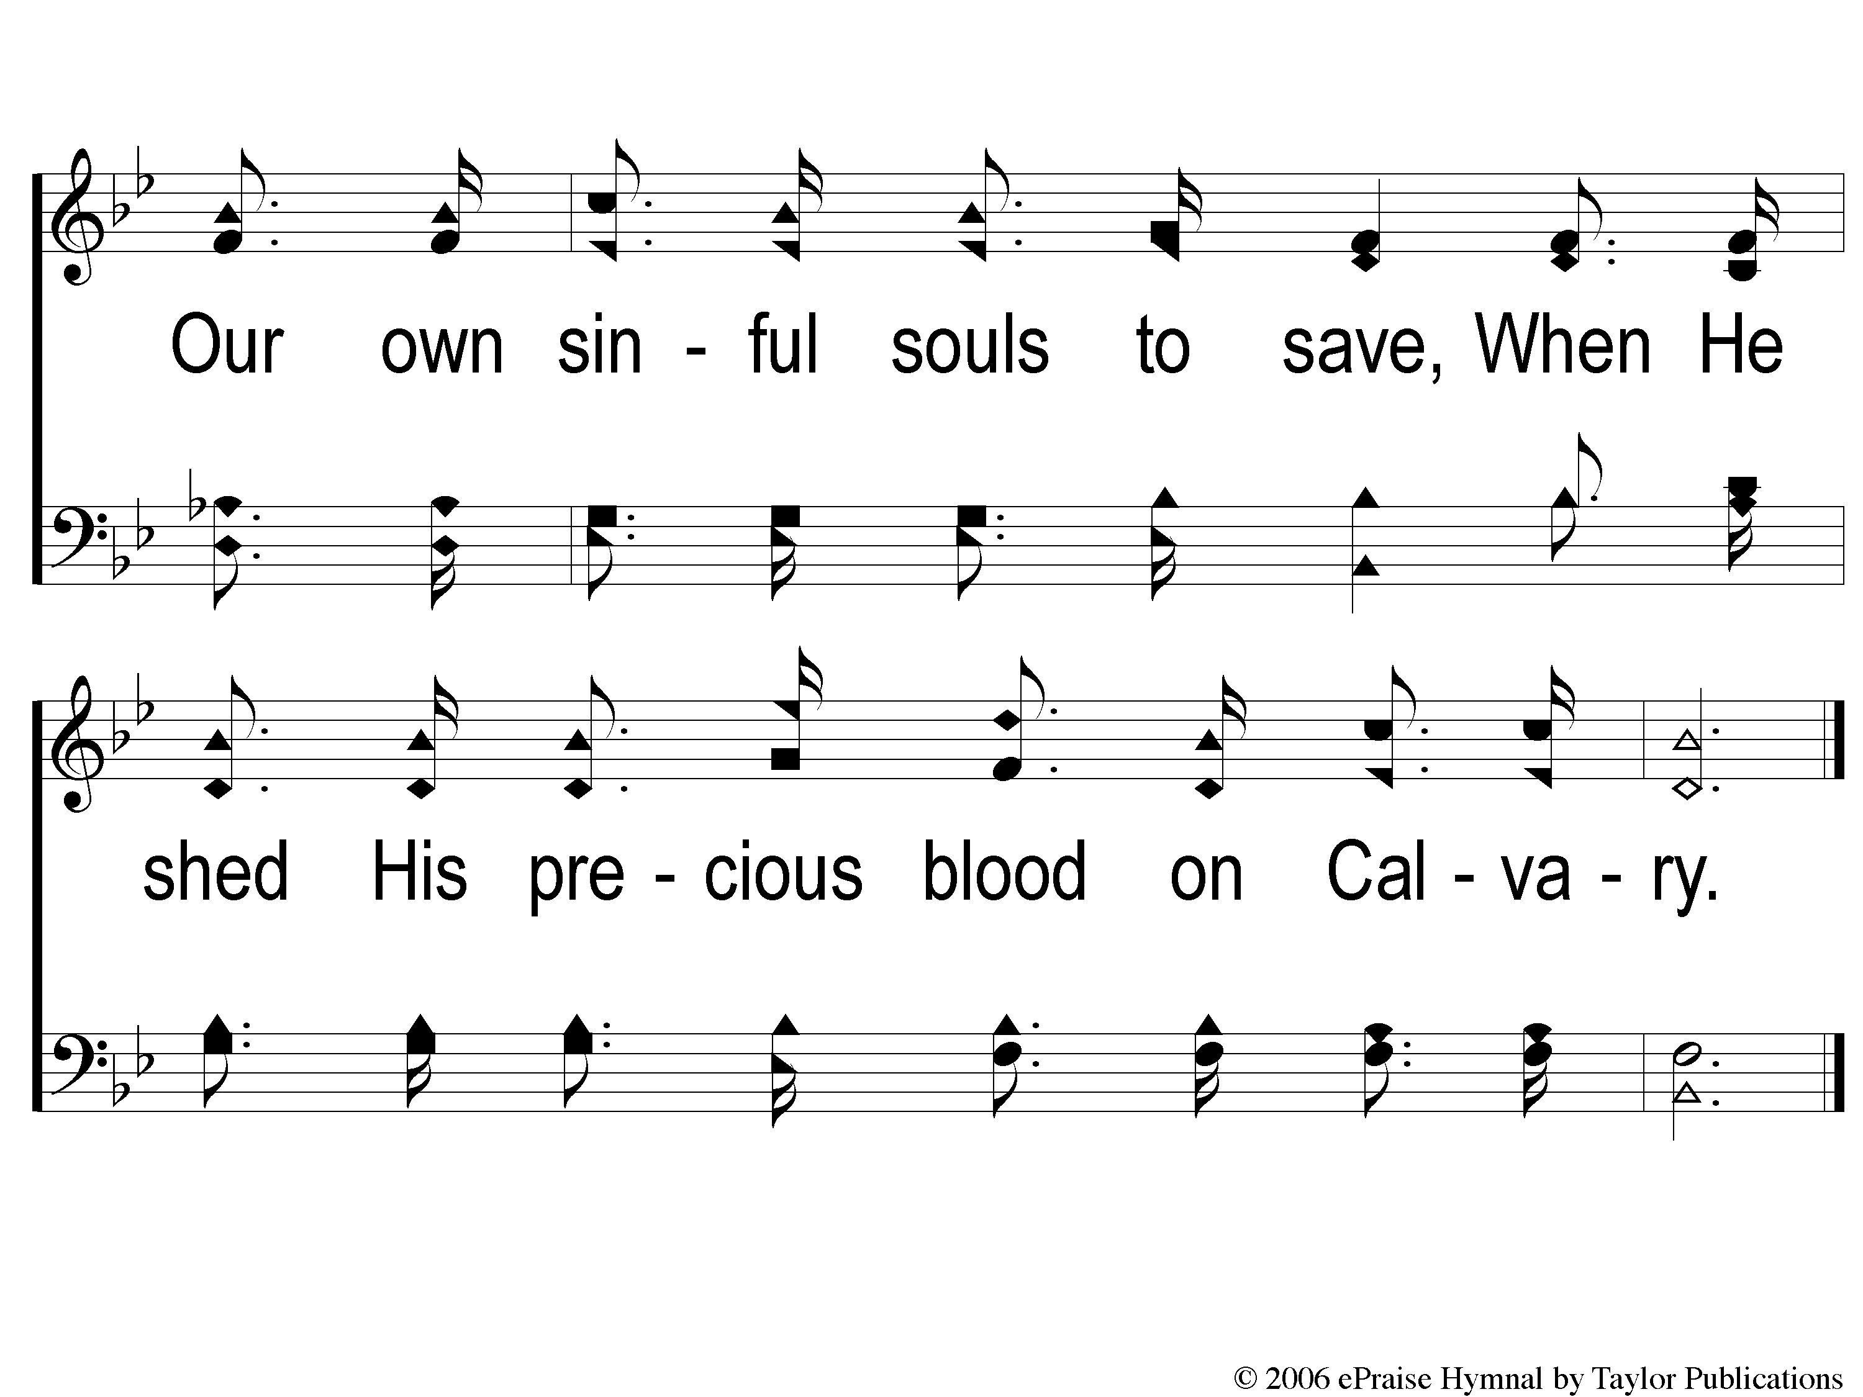
C-3 Oh What Love
Oh What Love
117

Slide 7
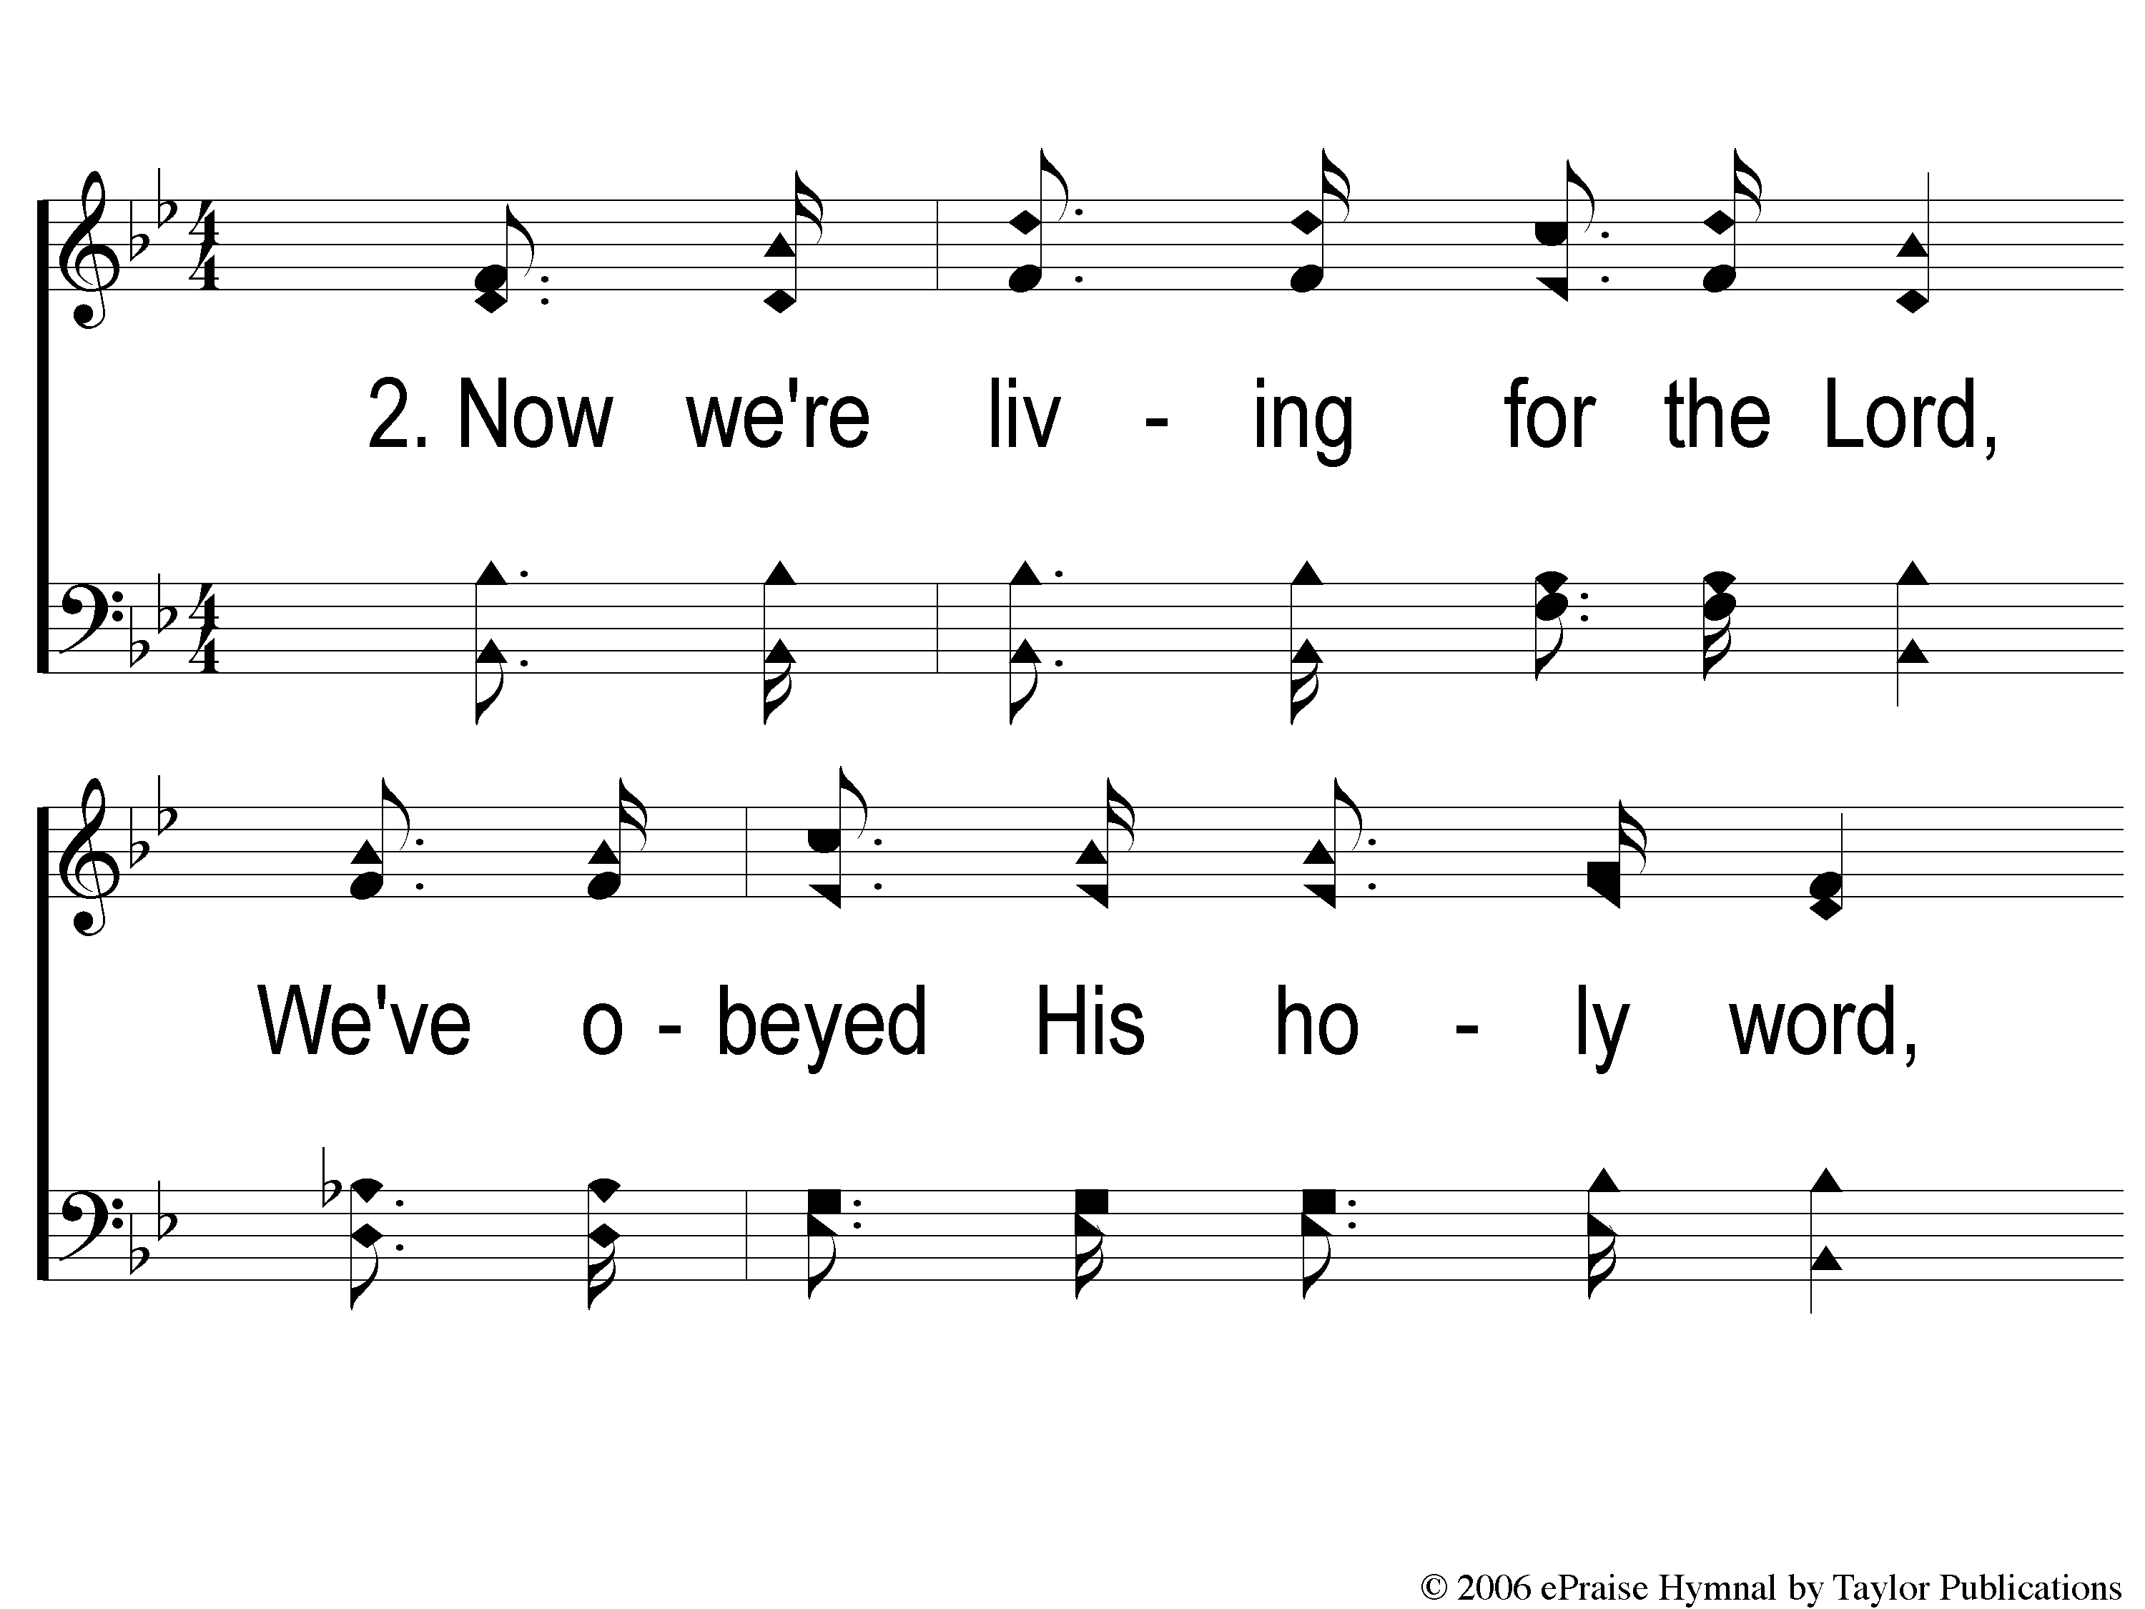
2-1 Oh What Love
Oh What Love
117

Slide 8
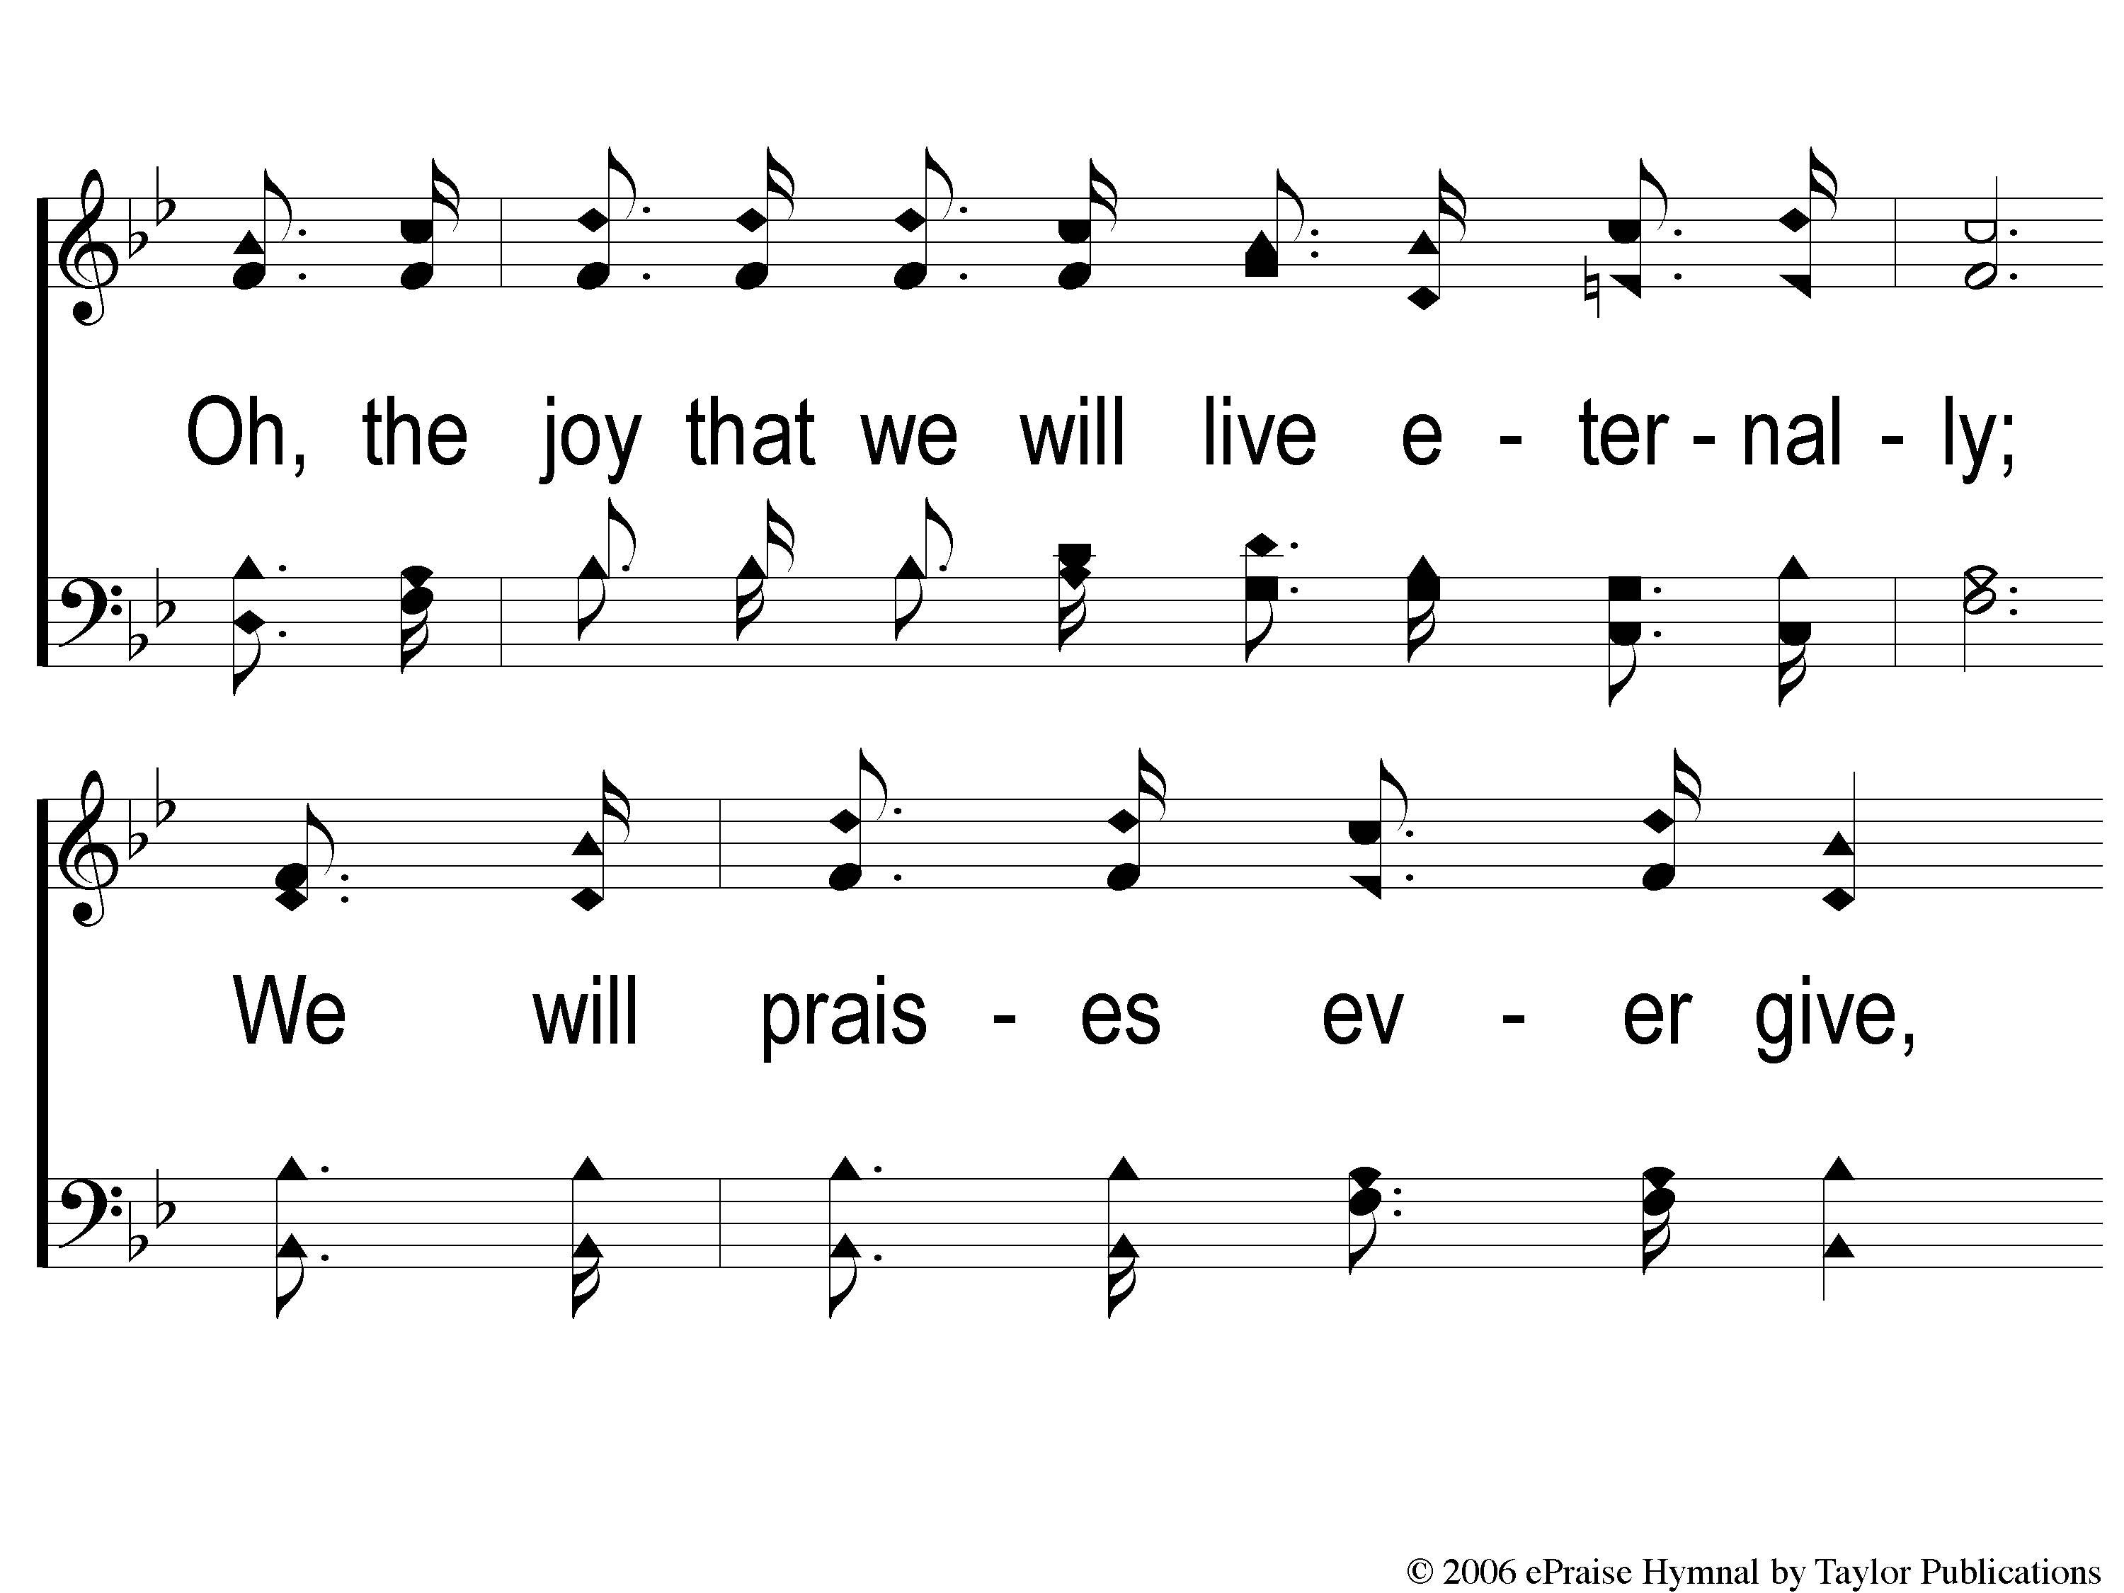
2-2 Oh What Love
Oh What Love
117

Slide 9
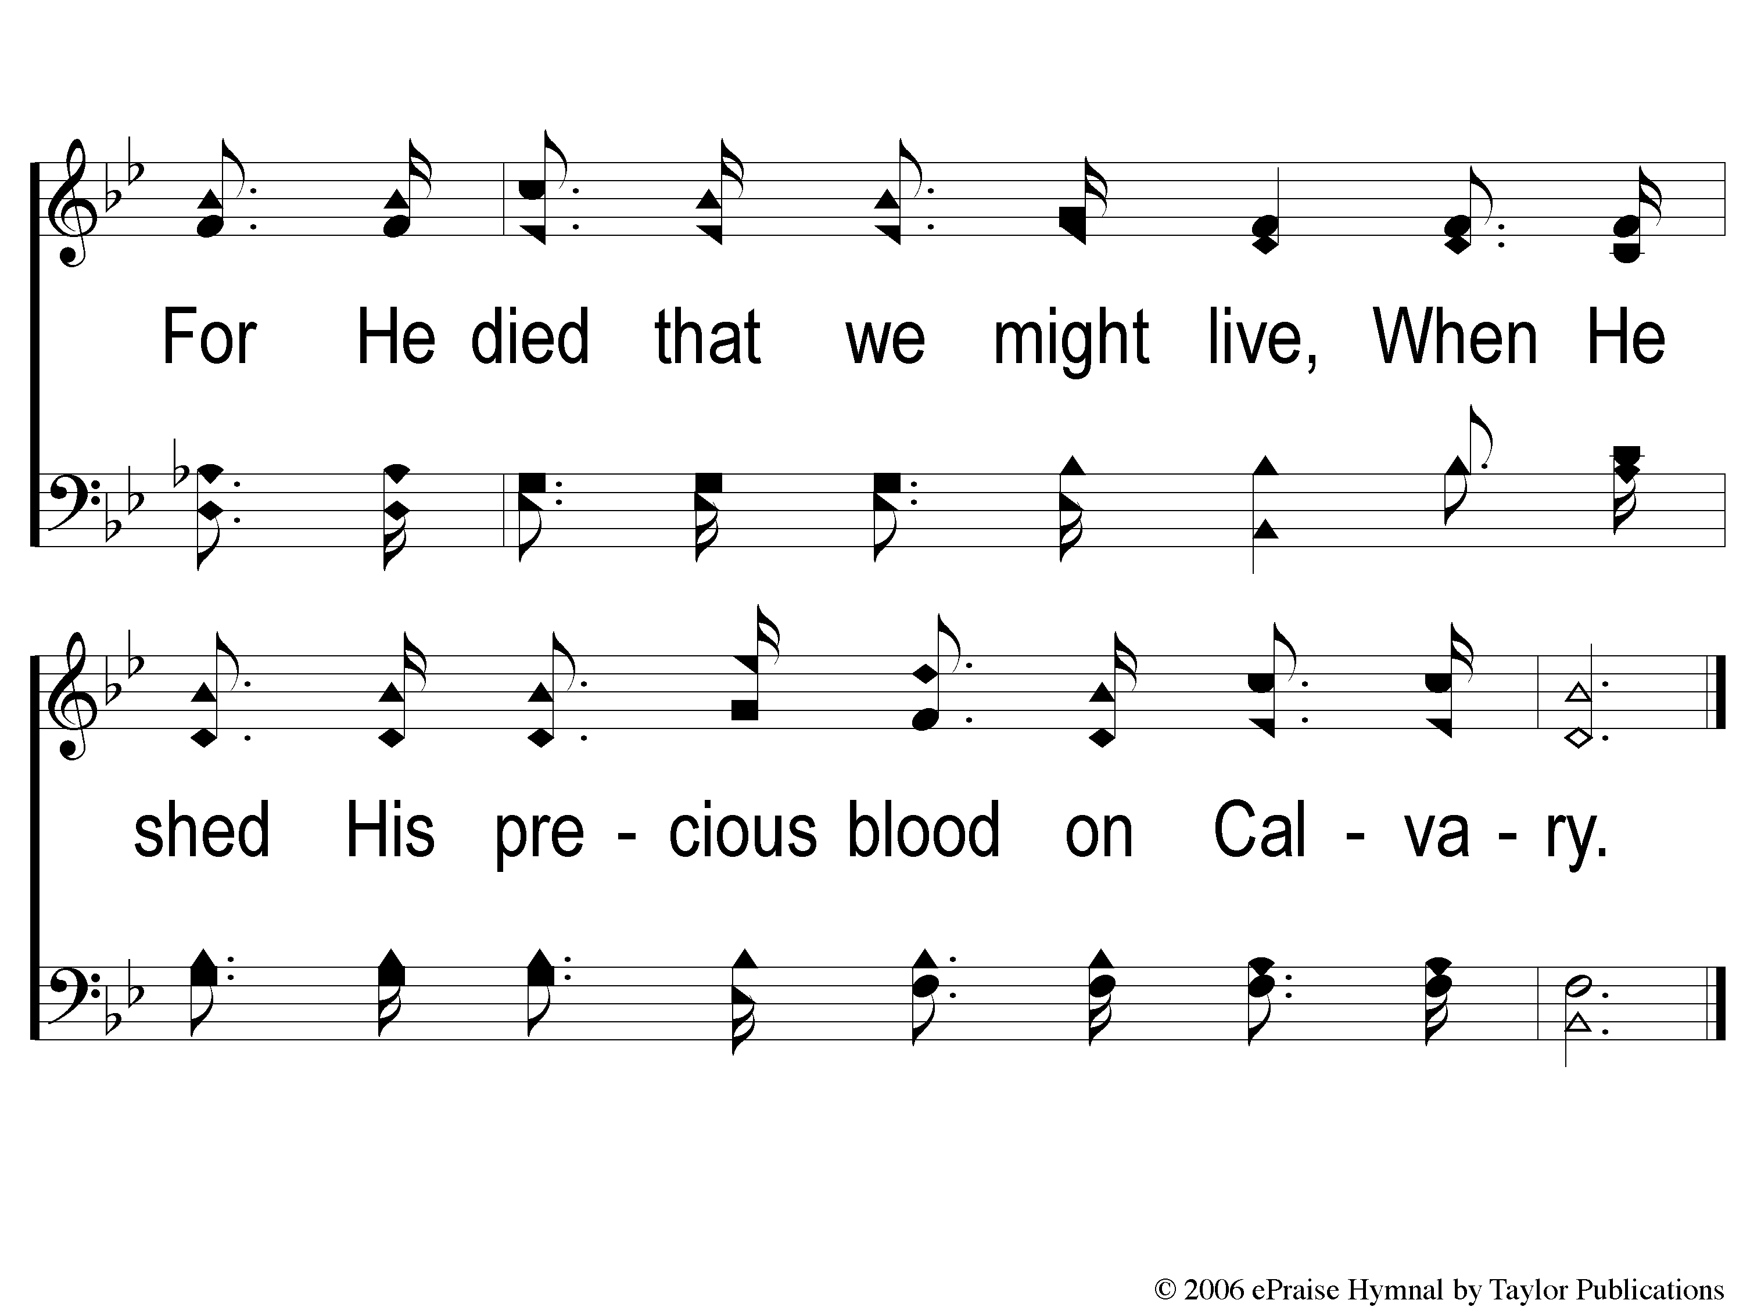
2-3 Oh What Love
Oh What Love
117

Slide 10
C-1 Oh What Love
Oh What Love
117

Slide 11
C-2 Oh What Love
Oh What Love
117

Slide 12
C-3 Oh What Love
Oh What Love
117

Slide 13
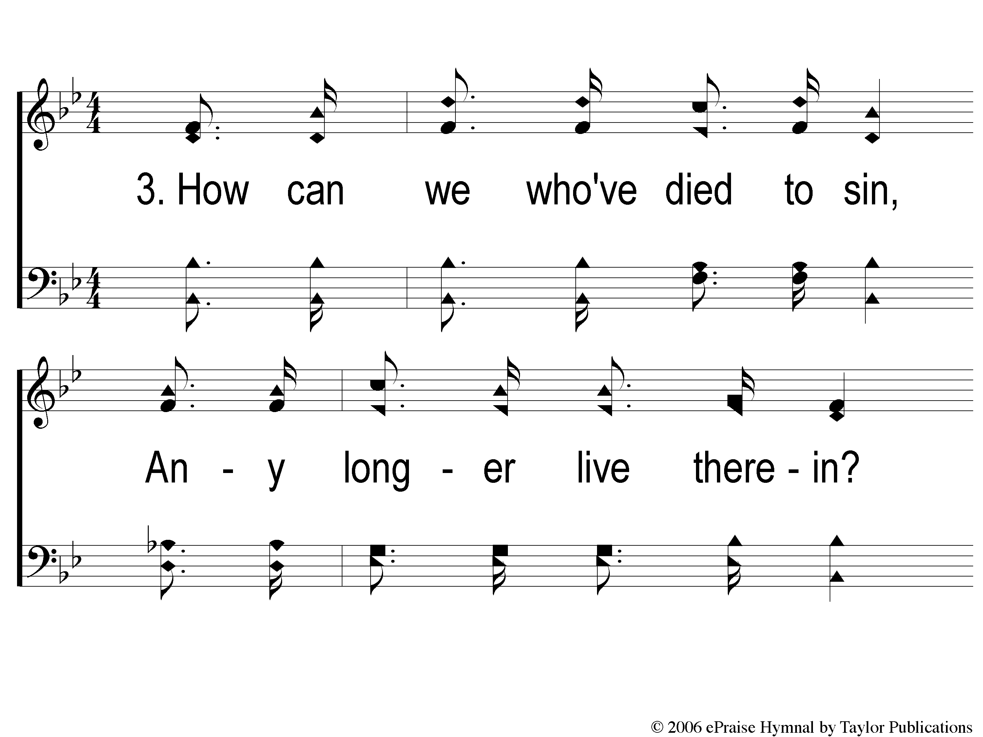
3-1 Oh What Love
Oh What Love
117

Slide 14
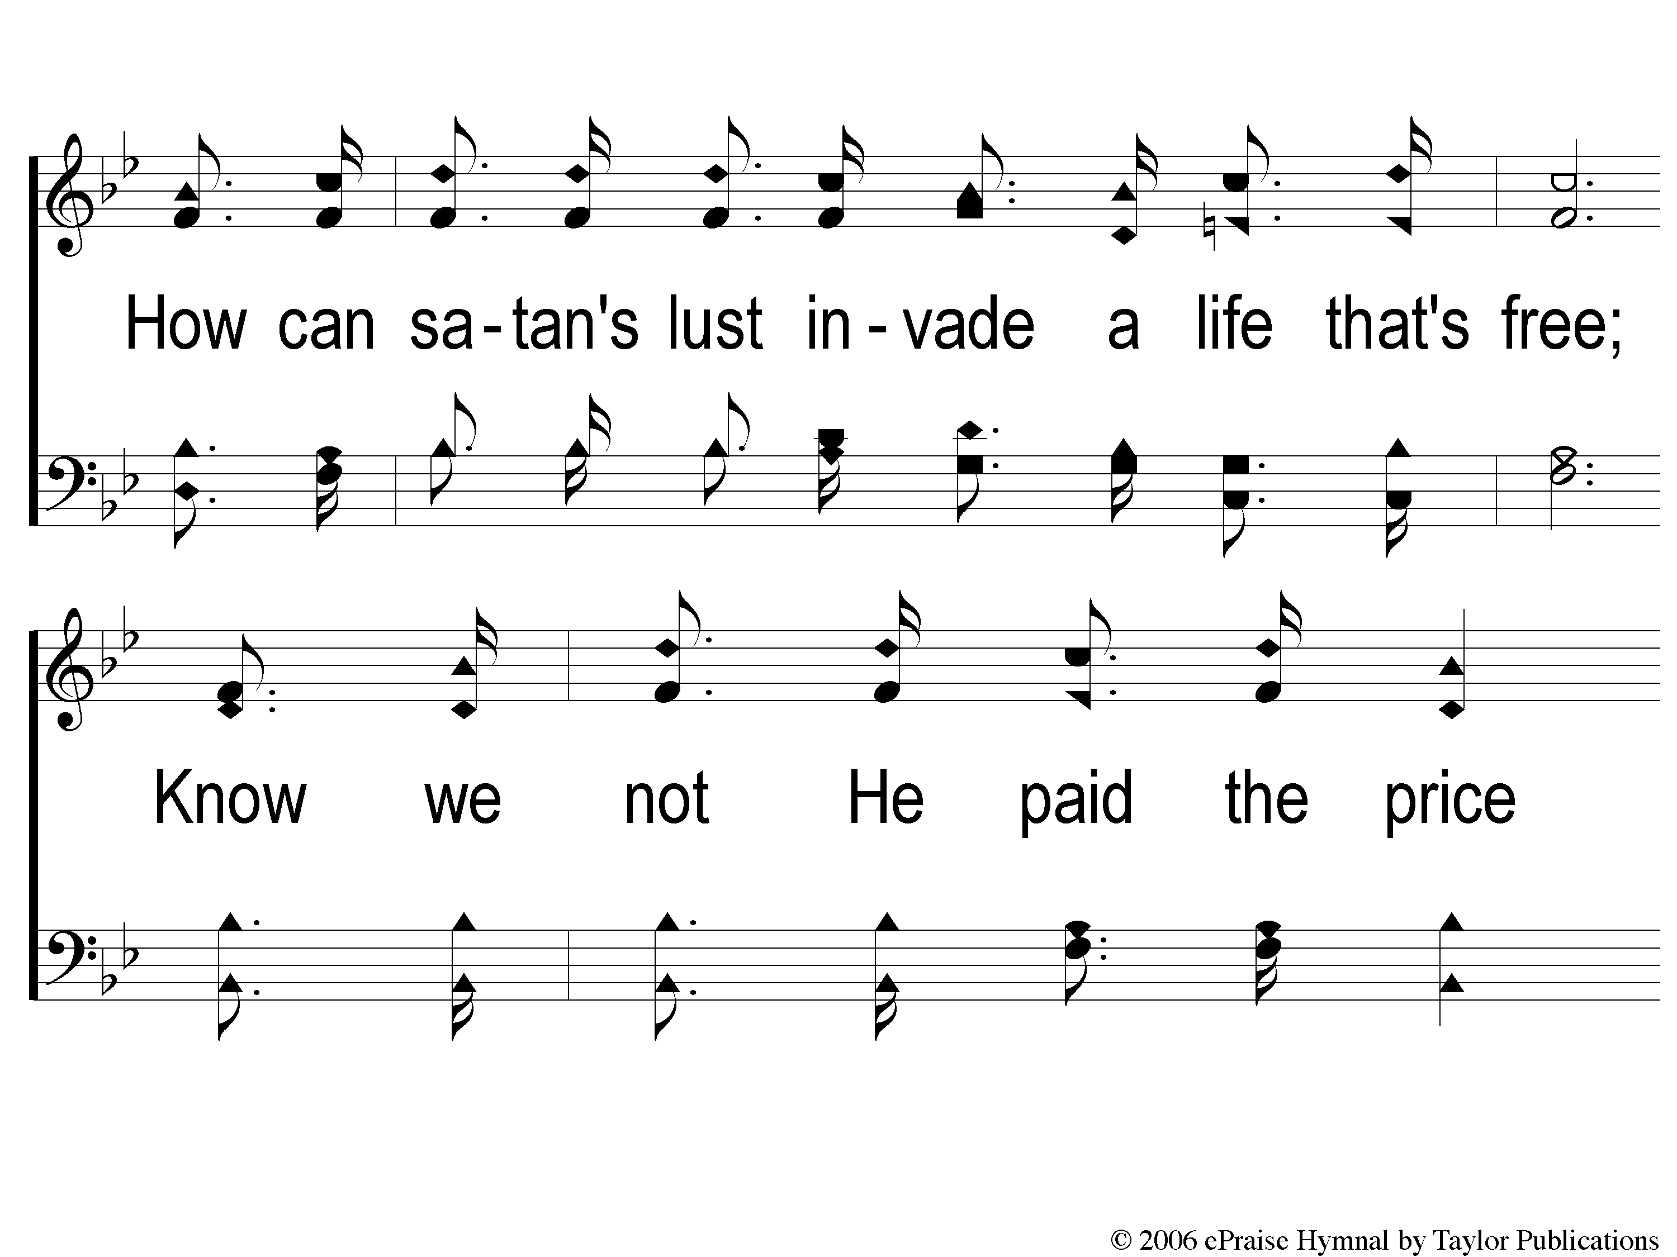
3-2 Oh What Love
Oh What Love
117

Slide 15
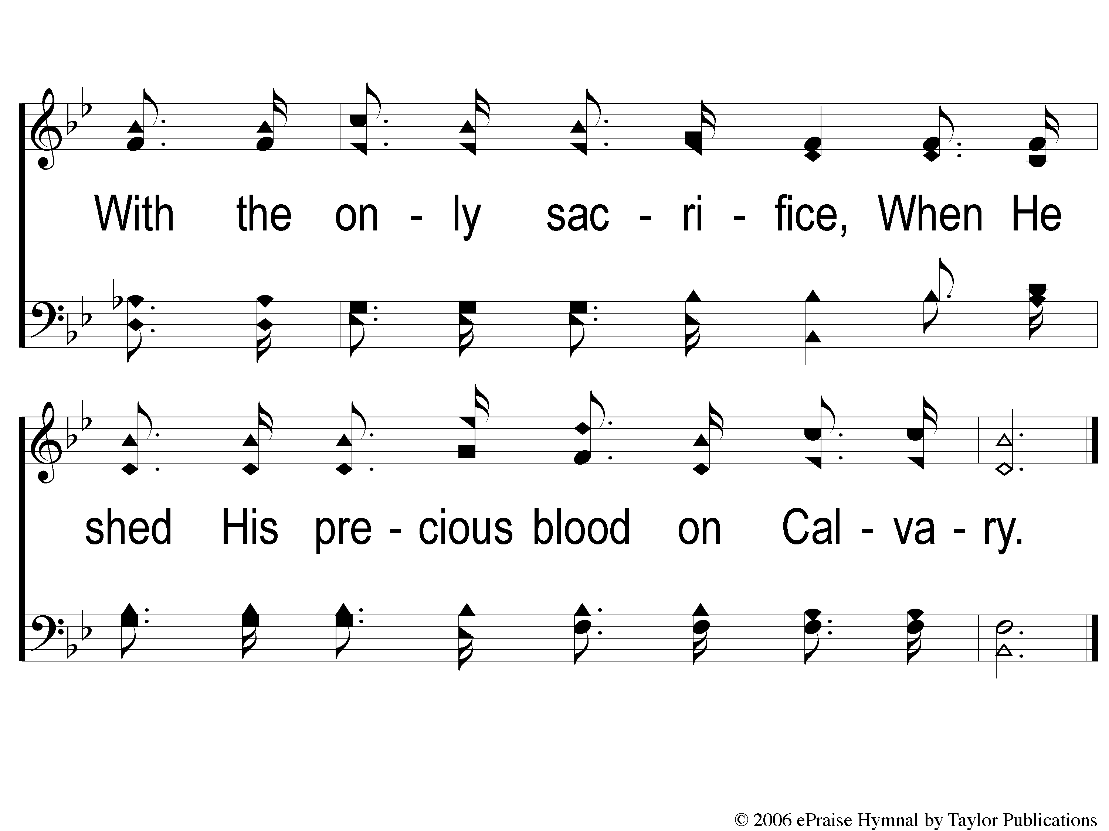
3-3 Oh What Love
Oh What Love
117

Slide 16
C-1 Oh What Love
Oh What Love
117

Slide 17
C-2 Oh What Love
Oh What Love
117

Slide 18
C-3 Oh What Love
Oh What Love
117

